Slide 1


Credit Card Fraud Demo Overview
Notes:
TALK TRACK
Hello, my name is [NAME] and I want to thank you for taking time to speak with me today.
Hortonworks Powers the Future of Data: data-in-motion, data-at-rest, and Modern Data Applications.
Today, I’ll tell you how we do that and how you can transform your business by managing your data with Hortonworks Connected Data platforms.
[NEXT SLIDE]

Slide 2
Credit Card Fraud Demo Overview
This demo presents the use case of a payment processor or credit card company processing raw transactions, ingesting via NiFi in real-time, routing from NiFi to Kafka and then Storm, enriching data with data found in Hbase, utilizing Spark Machine Learning to detect fraudulent transactions, and then posting to a custom dashboard for analysis and fraud alerts
Analysts have the ability to manually trigger alerts to send to customers, who receive them on their mobile phones
Customers can then confirm transaction is fraudulent or not
That information is used to update HBase account detail tables
The next few slides will go into greater detail about the architecture of the demo and the components of the Hortonworks tech that it uses.

Slide 3
Architecture
This Demo uses the following components:
NiFi
Kafka
Storm
Streaming Analytics Manager
HBase
Spark MLLib
Zeppelin
Storm
Kafka
Mobile App
HBase
Transaction Feed
NiFi
Kafka
Storm
CometD
Web App
Spark

Slide 4
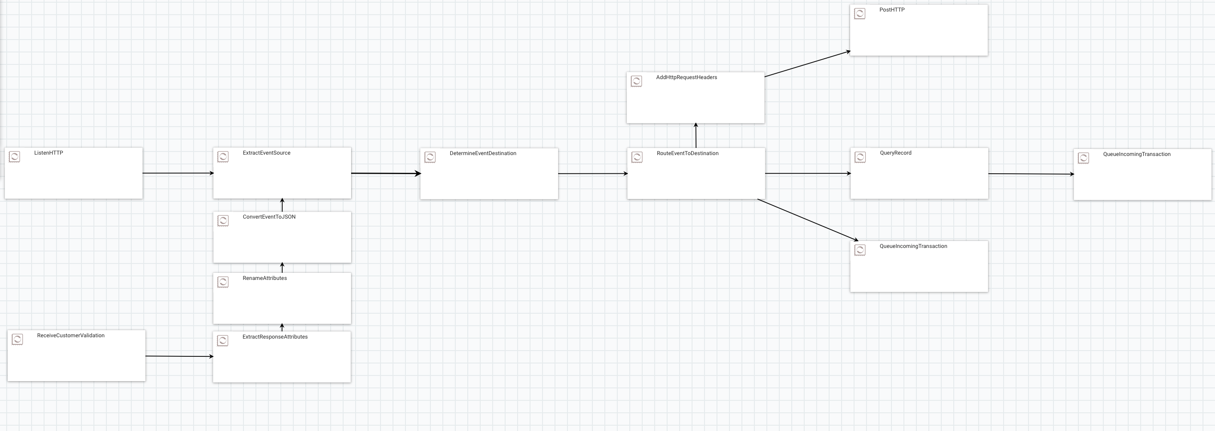

Apache NiFi
NiFi gives users the unique ability to move and transform data.
Very simple drag and drop interface for processors allows a simple user experience
Extensible
Maintains data provenance

Slide 5
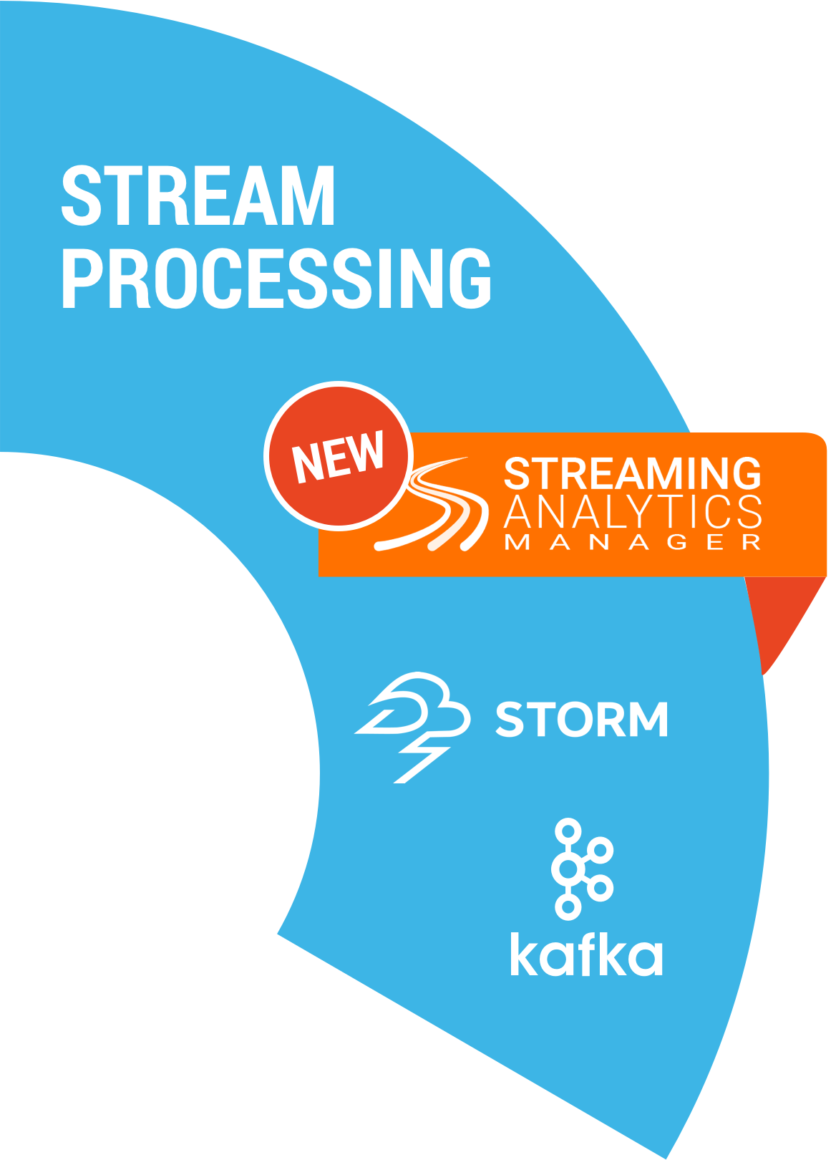
Introducing Hortonworks Streaming Analytics Manager (SAM)
Design, develop, deploy and manage streaming analytics app with a drag-and-drop paradigm
Streaming Analytics Manager

Slide 6

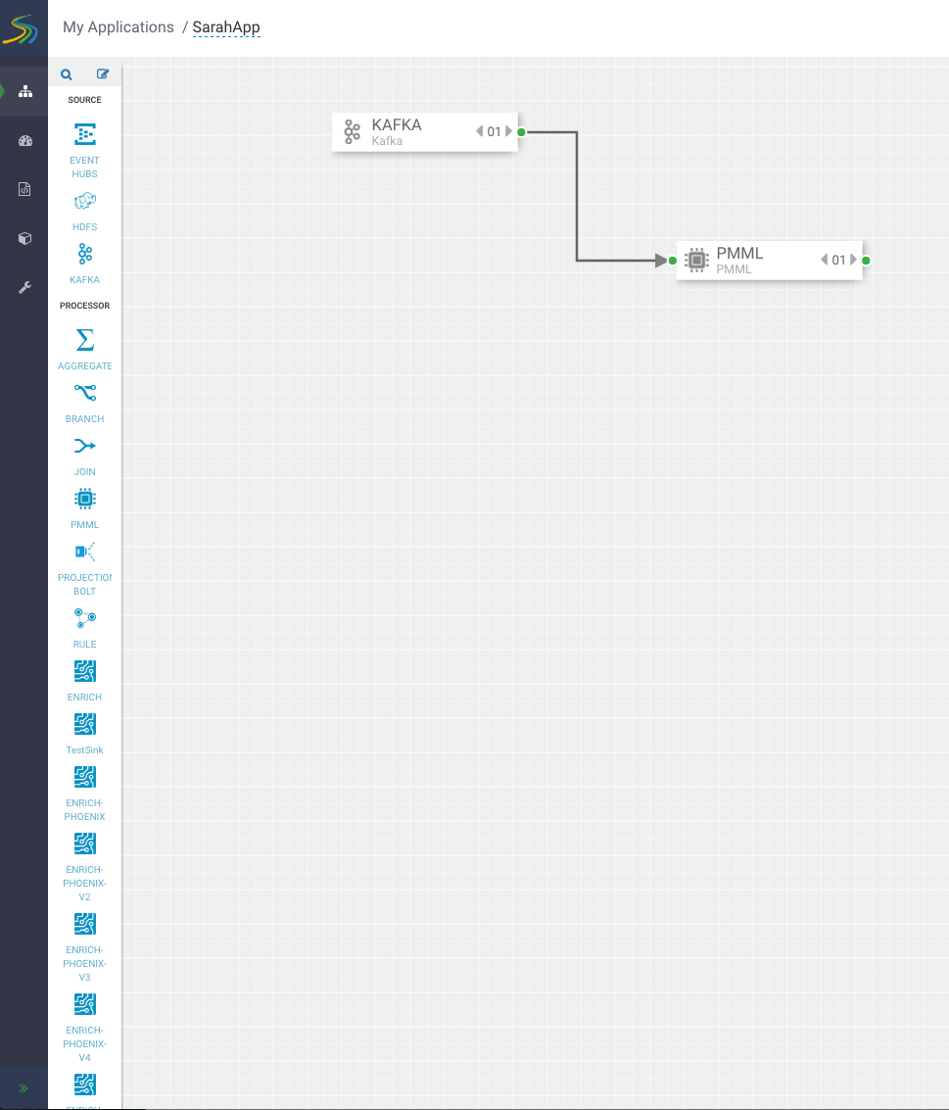
Stream Builder
Builder components, shown on the canvas palette, are the building blocks used by the app developer to build streaming apps.
Drag and drop to build a working streaming application without writing a single line of code.
4 Types of Components: Sources, Processors, Sinks and Custom

Slide 7
SAM is All about Doing Real-Time Analytics on Streams
Real-Time Analytics
Real-Time
Prescriptive Analytics
Real-Time
Predictive Analytics
Real-Time
Descriptive Analytics
What should we do right now?
What could happen now/soon?
What is happening right now?
event correlation
enrichment, routing & filtering
pattern matching
rule-based classification
statistical aggregations with UDAF
Spark mllib model deployment
time series dashboards
visualizations
OLAP queries via Druid

Slide 8
Storm and SAM
Receives transactions from Kafka topic: incoming_transaction
Enriches with customer details from HBase tables
Utilizes stored PMML Spark machine learning algorithm to predict if a transaction is fraudulent
Model was created using features: transactionID, latitude, longitude, time stamp
Publishes transaction to web app UI using CometD

Slide 9
Web App UI

Slide 10
Demo

